Slide 1
SIMPLE MAIL TRANSFER PROTOCOL
PRADEEP KOLLIPARA SANDEEP PINNAMANENI

Slide 2
Introduction
Simple Mail Transfer Protocol is the standard e-mail protocol on the Internet and part of the TCP/IP protocol suite. SMTP defines the message format and the message transfer agent (MTA), which stores and forwards the mail. SMTP was originally designed for only plain text (ASCII text), but MIME and other encoding methods enable executable programs and multimedia files to be attached to and transported with the e-mail message.
SMTP is a relatively simple, text-based protocol, where one or more recipients of a message are specified and then the message text is transferred. SMTP uses TCP port 25.

Slide 3
Purpose
The primary purpose of SMTP is to transfer email between mail servers. However, it is critical for email clients as well. In order to send email, the client sends the message to an outgoing mail server, which in turn contacts the destination mail server for delivery. For this reason, it is necessary to specify an SMTP server when configuring an email client.
One important point to make about the SMTP protocol is that it does not require authentication. This allows anyone on the Internet to send email to anyone else or even to large groups of people. It is this characteristic of SMTP that makes junk email or spam possible.

Slide 4
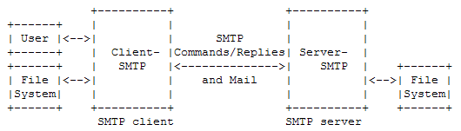
SMTP Model

Slide 5
Operation
When an SMTP client has a message to transmit, it establishes a two- way transmission channel to an SMTP server. The responsibility of an SMTP client is to transfer mail messages to one or more SMTP servers.
Once the transmission channel is established and initial handshaking completed, the SMTP client normally initiates a mail transaction. Such a transaction consists of a series of commands to specify the originator and destination of the mail and transmission of the message content (including any headers or other structure) itself.

Slide 6
Operation (contd..)
The server responds to each command with a reply; replies may indicate that the command was accepted, that additional commands are expected, or that a temporary or permanent error condition exists.
Once a given mail message has been transmitted, the client may either request that the connection be shut down or may initiate other mail transactions.

Slide 7
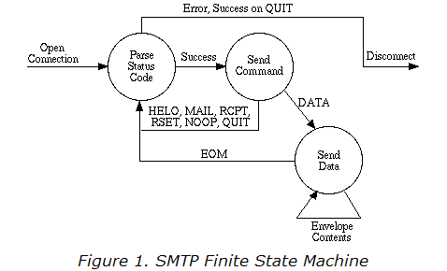
State Machine

Slide 8
Basic Commands
SMTP defines a small required command set, with several optional commands included for convenience purposes. The minimal set required for an SMTP sending client are:
HELO - Initial State Identification
MAIL - Mail Sender Reverse Path
RCPT - One Recipient’s Forward Path
DATA - Mail Message Text State
RSET - Abort Transaction and Reset all buffers
NOOP - No Operation
QUIT - Commit Message and Close Channel

Slide 9
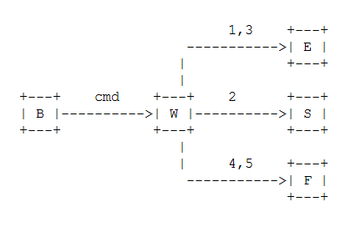
State Diagram for Commands
For each command there are three possible outcomes:
"success"(S), "failure" (F), and "error" (E). In the state diagram above
we use the symbol B for "begin", and the symbol W for "wait for
reply".

Slide 10
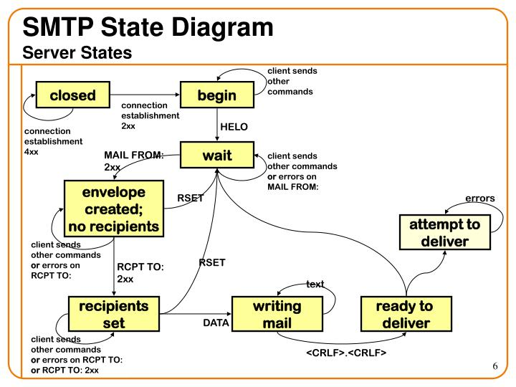

Slide 11
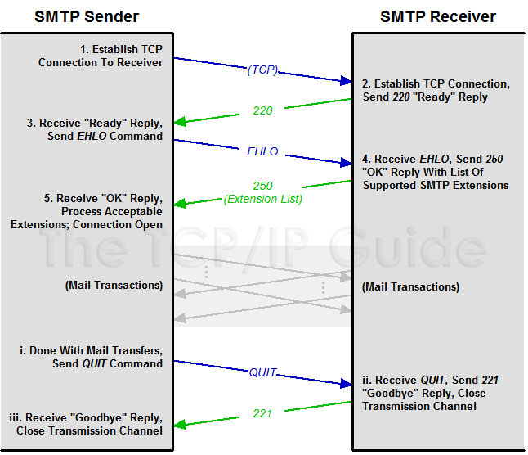

Slide 12
SMTP PROCEDURE
There are three steps in SMTP mail transactions.
- The transaction is started with a MAIL command which gives the sender identification. If accepted the receiver-SMTP returns a 250 OK reply.
- A series of one or more RCPT commands follows giving the receiver information. If accepted, the receiver-SMTP returns a 250 OK reply, and stores the forward-path. If the recipient is unknown the receiver-SMTP returns a 550 Failure reply.
- Then a DATA command gives the mail data. If accepted, the receiver-SMTP returns a 354 Intermediate reply and considers all succeeding lines to be the message text. And finally, the end of mail data indicator confirms the transaction. When the end of text is received and stored the SMTP-receiver sends a 250 OK reply.

Slide 13
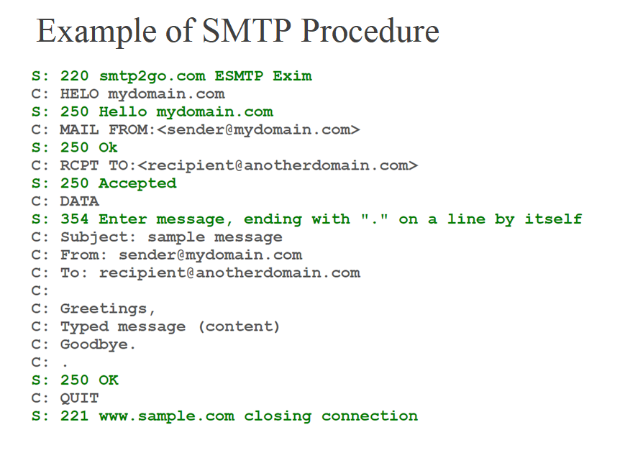

Slide 14
SMTP Replies
Replies to SMTP commands serve to ensure the synchronization of requests and actions in the process of mail transfer and to guarantee that the SMTP client always knows the state of the SMTP server.
Every command MUST generate exactly one reply.
An SMTP reply consists of a three digit number followed by some text. The number is for use by automata to determine what state to enter next; the text is for the human user.
Formally, a reply is defined to be the sequence: a three-digit code, <SP>, one line of text, and <CRLF>, or a multi-line reply.

Slide 15
List Of Reply Codes
211 System status, or system help reply .
214 Help message.
220 <domain> Service ready.
221 <domain> Service closing transmission channel.
250 Requested mail action okay, completed.
251 User not local; will forward to <forward-path>.
354 Start mail input; end with <CRLF>.<CRLF>.
421 <domain> Service not available, closing transmission channel. [This may be a reply to any command if the service knows it must shut down].
450 Requested mail action not taken: mailbox unavailable.
451 Requested action aborted: local error in processing
452 Requested action not taken: insufficient system storage.

Slide 16
List Of Reply Codes (cont…)
500 Syntax error, command unrecognized. [This may include errors such as command line too long]
501 Syntax error in parameters or arguments.
502 Command not implemented.
503 Bad sequence of commands.
504 Command parameter not implemented.
550 Requested action not taken: mailbox unavailable.
551 User not local; please try <forward-path>.
552 Requested mail action aborted: exceeded storage allocation.
553 Requested action not taken: mailbox name not allowed. [E.g., mailbox syntax incorrect]
554 Transaction failed.

Slide 17
Problems with simple SMTP
The first one relates to message length. Some older implementations cannot handle messages exceeding 64KB.
Another problem relates to timeouts. If the Client and server have different timeouts, one of them may give up while the other is still busy, unexpectedly terminating the connection.
Security issue

Slide 18
ESMTP (RFC 2821)
To get around the problems with simple SMTP, extended SMTP has been defined in RFC 2821. Clients wanting to use it should send an EHLO message instead of HELO initially. If this is rejected, then the server is a regular SMTP server, and the client should proceed in the usual way. If the EHLO is accepted, then new commands and parameters are allowed.

Slide 19
Time-out in ESMTP
An SMTP client MUST provide a timeout mechanism. To implement this, a timer is set for each SMTP command and for each buffer of the data transfer.
The minimum per-command timeout values SHOULD be as follows:
Initial 220 Message: 5 minutes.
MAIL Command: 5 minutes.
RCPT Command: 5 minutes.
DATA Initiation: 2 minutes.
Data Block: 3 minutes.
DATA Termination: 10 minutes.

Slide 20
Reliable Delivery and Replies by E-mail
When the receiver-SMTP accepts a piece of mail (by sending a "250 OK" message in response to DATA), it is accepting responsibility for delivering or relaying the message.
If there is a delivery failure after acceptance of a message, the receiver-SMTP MUST formulate and mail a notification message. This notification MUST be sent using a null ("<>") reverse path in the envelope. The recipient of this notification MUST be the address from the envelope return path. However, if this address is null ("<>"), the receiver-SMTP MUST NOT send a notification.

Slide 21
SMTP Security and Spamming
One of the limitations of the original SMTP is that it has no facility for authentication of senders. Therefore the SMTP-AUTH extension was defined. In spite of this, E-mail spamming is still a major problem. Modifying SMTP extensively, or replacing it completely, is not believed to be practical, due to the network effects of the huge installed base of SMTP. INTERNET MAIL 2000 is one such proposal for replacement.
SMTP mail is inherently insecure in that it is feasible for even fairly casual users to negotiate directly with receiving and relaying SMTP servers and create messages that will trick a naive recipient into believing that they came from somewhere else.

Slide 22
References
http://www.faqs.org/rfcs/rfc821.html
www.ncsl.org/programs/lis/cip/ppt/sjohnson03/sld009.html
www.faqs.org/rfcs/rfc2821.html
http://afrodita.rcub.bg.ac.yu/redhat/docs80/rhl-rg-en-8.0/ch-email.html
www.postech.ac.kr/cse/hpc/research/webcache/book/apps/ftp.htm
www.faqs.org/rfcs/rfc2920.html
www.faqs.org/rfcs/rfc3030.html
www.faqs.org/rfcs/rfc2487.html

